Slide 1
RESEARCH METHDOLOGY IN SOCIOLOGY
Ms. Shahtaj Shakir
Sociology -Lecturer
FAST NUCES

Slide 2
Learning outcomes:
State what topics are valid for sociologists to study
Explain why common sense can’t replace sociological research
Know the eight steps of the research model
Know the main elements of the seven research methods: surveys, participant observation, case studies, secondary analysis, analysis of documents, experiments, and unobtrusive measures; state why sociological research can lead to controversy.
Explain how gender is significant in sociological research.
Explain why it’s vital for sociologists to protect the people they study; discuss the case that are presented
Explain how research and theory work together in sociology
Notes:
Source: the course book, Sociology-A Down-to-Earth Approach- 13th edition by James. M. Henslin,

Slide 3
introduction
Sociologists are scientists who study human social behaviors. They contribute important knowledge about how people interact at varying social levels, from small groups like family units to major institutions like the government or even entire cultures. However, it’s important for sociologists to understand the different research methods used in the social sciences so they can be sure their research produces accurate and meaningful conclusions
Notes:
Source: the course book, Sociology-A Down-to-Earth Approach- 13th edition by James. M. Henslin,

Slide 4
State what topics are valid for sociologists to study
Sociologists do research on just about every area of human behavior.
1)Macro level: looks at large-scale social processes, such as social stability and change, the laws, the military and the global economic crisis (Fligstein and Habinek 2014).
2) Micro-level sociology looks at small-scale interactions between individuals, such as conversation or group dynamics, how people interact on street corners and even shyness (Scott 2006).
Micro- and macro-level studies each have their own benefits and drawbacks. Sociologists study nuns and prostitutes, cops and criminals, as well as all kinds of people in between.

Slide 5
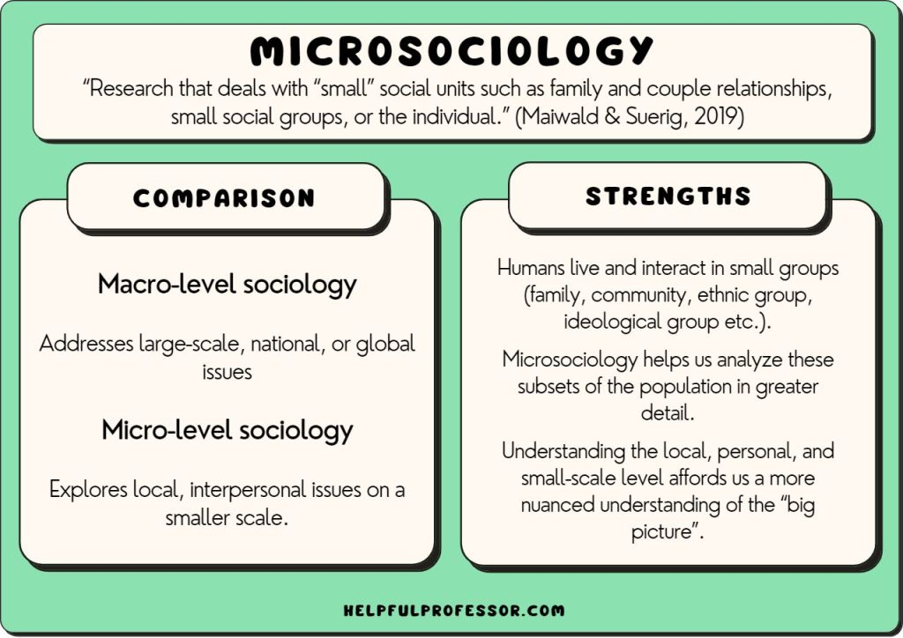
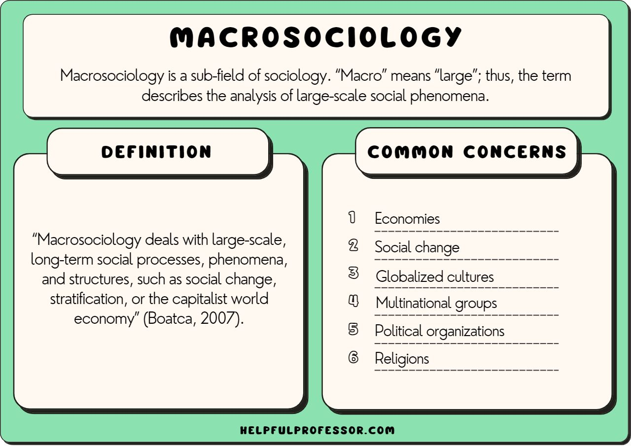

Slide 6
Explain why common sense can’t replace sociological research
Common Sense promotes stereotypical beliefs but sociology uses reason and logic.
Common sense is based upon assumptions while sociology is based upon evidences.
Empirical testing has no place in common sense knowledge whereas Sociology pursue research with an empirical orientation.
Notes:
Source: the course book, Sociology-A Down-to-Earth Approach- 13th edition by James. M. Henslin,

Slide 7
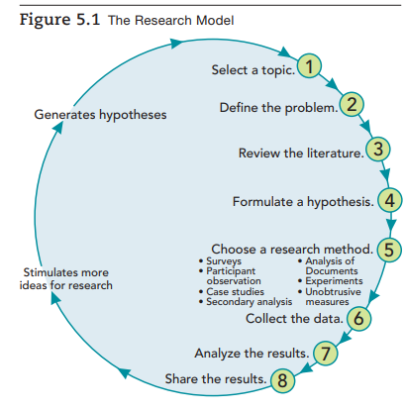
Know the eight steps of the research model.
Scientific research follows eight basic steps.
In the real world of research, some of these steps may run together. Some may even be omitted.
Notes:
Source: the course book, Sociology-A Down-to-Earth Approach- 13th edition by James. M. Henslin,

Slide 8
1. Selecting a topic
The first step is to select a topic.
What do you want to know more about?
Many sociologists simply follow their curiosity, their drive to learn more about social life.
They become interested in a particular topic, and they pursue it eg: studying the homeless, spouse abuse
Some sociologists choose a topic because funding is available, others because they want to help people better understand a social problem and perhaps to help solve it.

Slide 9
2. define the problem
The second step is to define the problem, to specify what you want to learn about the topic.
Example: they examine some specific aspect of a topic, such as how homeless people survive on the streets.
In the case of spouse abuse, sociologists may want to know whether violent and nonviolent husbands have different work experiences.
Or they may want to learn what can be done to reduce spouse abuse.

Slide 10
3. REVIEWING THE LITERATURE
You must read what has been published on your topic.
This helps you to narrow the problem, identify areas that are already known, and learn what areas need to be researched.
Reviewing the literature may also help you to pinpoint the questions that you will ask.
You might even find out that what you are interested in learning has been answered already.
You don’t want to waste your time rediscovering what is already known

Slide 11
4.formulating a hypothesis
A research hypothesis is a statement of expectation or prediction that will be tested by research
A statement of what you expect to find according to predictions from a theory.
A hypothesis predicts a relationship between or among variables, factors that change, or vary, from one person or situation to another.
For example, the statement “Men who are more socially isolated are likelier to abuse their wives than men who are more socially integrated” is a hypothesis.
Your hypothesis will need operational definitions that is, precise ways to measure the variables. In this example, you would need operational definitions for three variables: social isolation, social integration, and spouse abuse.
Notes:
An operational definition is how we (the. researcher) decide to measure our the variables. in our study (variable = anything that can be measured). ◦ There are usually hundreds of ways to measure a DV (e.g. behavior)

Slide 12
5. choosing a research method
You then need to decide how you are going to collect your data.
Sociologists use seven basic research methods (or research designs), which are outlined in the next section. You will want to choose the research method that will best answer your particular questions.

Slide 13
6. collecting the data
When you gather your data, you have to take care to assure their validity; that is, your operational definitions must measure what they are intended to measure.
In this case, you must be certain that you really are measuring social isolation, social integration, and spouse abuse and not something else.
Spouse abuse, for example, seems to be obvious. Yet what some people consider abusive is not regarded as abuse by others.
You must also be sure that your data are reliable
Reliability means that if other researchers use your operational definitions, their findings will be consistent with yours.
If your operational definitions are sloppy, husbands who have committed the same act of violence might be included in some research but excluded from other studies.

Slide 14
7. analyzing the results
You will have been trained in a variety of techniques to analyze your data from those that apply to observations of people in small settings to the analysis of large-scale surveys.
If a hypothesis has been part of your research, now is when you will test it. (Some research, especially participant observation and case studies, has no hypothesis.
You may know so little about the setting you are going to research that you cannot even specify the variables in advance.

Slide 15
8. sharing the results
To wrap up your research, you will write a report to share your findings with the scientific community.
You will review how you did your research and specify your operational definitions.
You will also compare your findings with published reports on the topic and examine how they support or disagree with theories that others have applied

Slide 16
Two key elements to research:
1. Validity addresses whether or not the research measures what it is intended to measure.
2.Reliability is the extent to which research produces consistent or dependable results
Notes:
http://www.csun.edu/~hbsoc126/soc1/chapter%205%20outline.pdf

Slide 17
Types of data in sociology research
In sociology, researchers often categorize their data into the following four categories:
Primary data: Primary data refers to information collected directly by the researcher themselves. This type of data often comes from surveys, interviews and observational studies.
Secondary data: Secondary data is information gleaned from previous researchers in sociology. This might include data from books, government data or scholarly journals.

Slide 18


.
Quantitative data: Quantitative data is information in numerical form. Researchers often collect this type of data through statistical methods, especially surveys.
Qualitative data: Qualitative data refers to information that is challenging to quantify in numerical terms.
Researchers often derive numerical data from visual and auditory observation such as transcripts of interviews, newspapers and web sites

Slide 19
Research Methods
1. Surveys are typically structured questionnaires designed to collect information from large numbers of people in standardized form.
Eg: A census is an example of a survey used by social science researchers. The census requires participants to self-report their demographic information, which the government uses to determine government representation and how to distribute federal funds to local communities.
Notes:
https://revisesociology.com/2016/01/03/research-methods-sociology/

Slide 20

2. In participant observation, a type of field research, It's a research method in which the sociologist actively participates in the research group and records their observations
Eg: a researcher interested in learning about the study habits of college students might visit a campus coffee shop or library to observe their behavior. They might note the number of students who study in these locations, the time of day most students prefer to study, whether the students prefer to study in groups or alone and how long their study sessions tend to last. To participate more directly, the researcher may ask to join a weekly study group and assess how the students interact in each meeting during the semester.

Slide 21
3. Secondary analysis, which is the analysis of data already collected by other researchers, is used when resources are limited and/or existing data may provide excellent sources of information.
However, because the researcher did not directly carry out the research, he or she cannot be sure that the data were systematically gathered, accurately recorded, and biases avoided.
E.g: An example of a secondary analysis may be a researcher conducting a meta-analysis that analyzes every study on the academic achievement of third-grade students in New York City within the last 10 years.
Notes:
https://revisesociology.com/2016/01/03/research-methods-sociology/

Slide 22
4. Experiments are especially useful in determining causal relationships.
An experimental study typically takes place in a controlled environment, such as a laboratory. Since researchers minimize the influence of outside forces within the environment, this research method may help them identify causal relationships between the experimental groups.
Eg: An example of a research experiment in sociology may be a scientist studying how individuals subconsciously change their speech patterns when talking to someone they perceive as an authority figure.

Slide 23
5. Unobtrusive measures involve observing social behavior of people who do not know they are being studied. It is simply the methods of studying social behavior without affecting it. a measure obtained without disturbing the participant or alerting him or her that a measurement is being made.
Eg: analyze a painting a written document, photos, films, and things like face book Or a researcher may observe passersby in a public park from a nearby café and document their activities.

Slide 24

Significant of Gender in Sociological Research
Gender is in your own life, how it affects your orientations and attitudes. Because gender is so influential, researchers take steps to prevent it from biasing their findings.
For example:
Gender certainly can be an impediment in research. In our imagined research on
spouse abuse, for example, could a man even do participant observation of women who
have been beaten by their husbands? Technically, the answer is yes. But because the
women have been victimized by men, they might be less likely to share their experiences
and feelings with men. If so, women would be better suited to conduct this research,
more likely to achieve valid results. The supposition that these victims will be more open
with women than with men, however, is just that—a supposition. Research alone would
verify or refute this assumption.
Notes:
Source: the course book, Sociology-A Down-to-Earth Approach- 13th edition by James. M. Henslin,

Slide 25
Ethics in Sociological Research
In addition to choosing an appropriate research method, Sociologists follow the
ethics of sociology.
Research ethics require honesty, truth, and openness, (sharing findings with
the scientific community). Ethics clearly forbid the falsification of results, as well as plagiarism (stealing someone else’s work)
Notes:
Source: the course book, Sociology-A Down-to-Earth Approach- 13th edition by James. M. Henslin,

Slide 26
Ethics in Sociological Research
Another ethical guideline states that, generally, people should be informed that they are being studied and that they never should be harmed by the research.
Sociologists are also required to protect the anonymity of those who provide information. Sometimes people reveal things that are intimate, potentially embarrassing, or otherwise harmful to themselves or others.
Finally, it generally is considered unethical for researchers to misrepresent themselves.
Notes:
Source: the course book, Sociology-A Down-to-Earth Approach- 13th edition by James. M. Henslin,

Slide 27

Case -Protecting the Subjects- Mario Brajuha
Research Mario Brajuha, a graduate student at the State University of New York at StonyBrook, was doing participant observation of restaurant workers.
He lost his job as a waiter when the restaurant where he was working burned down—a fire of “suspicious origin,” as the police said.
When detectives learned that Brajuha had taken field notes they asked to see them.
Because he had promised to keep the information confidential, Brajuha refused to hand the mover.
The district attorney then threatened to put Brajuha in jail. By this time, Brajuha’s notes had become rather famous, and unsavory characters—perhaps those who had set the fire—also wanted to know what was in them.
For two years, Brajuha refused to hand over his notes, even though he grew anxious and had to appear at several court hearings. Finally, the district attorney dropped the subpoena. When the two men under investigation for setting the fire died, the threats to Brajuha, his wife, and their children ended
Notes:
Source: the course book, Sociology-A Down-to-Earth Approach- 13th edition by James. M. Henslin,

Slide 28
How Research and Theory Work Together
Research and theory, then, are both essential for sociology. Every theory must be
tested, which requires research.
And as sociologists do research, often coming up with surprising findings, those results must be explained; for that, we need theory. As sociologists study social life, then, they combine research and theory.
Notes:
Source: the course book, Sociology-A Down-to-Earth Approach- 13th edition by James. M. Henslin,

Slide 29
THANK YOU!☺

